Slide 1
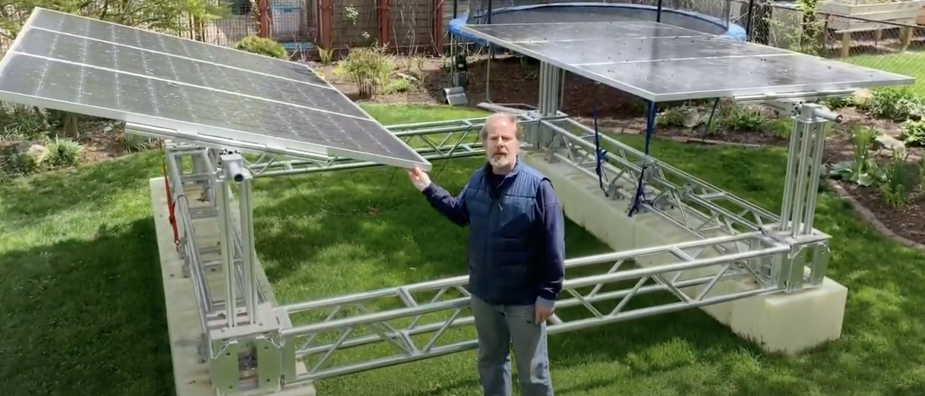
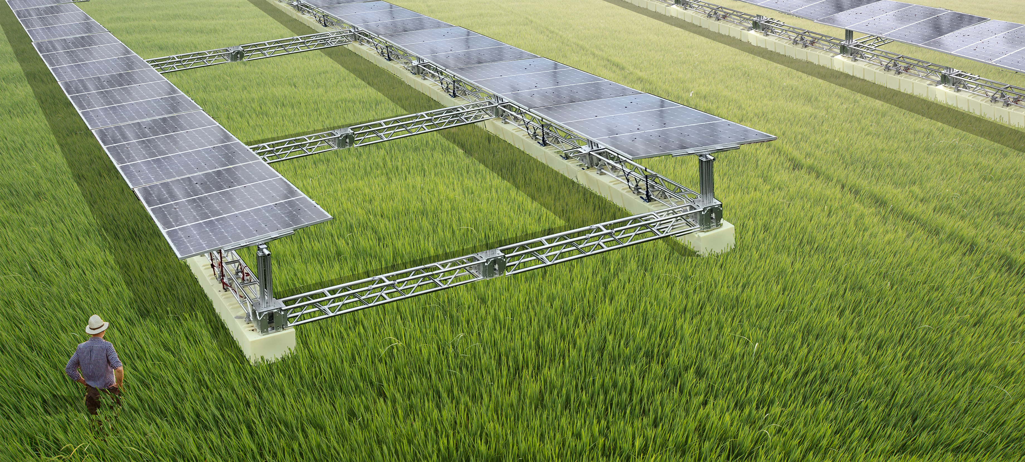
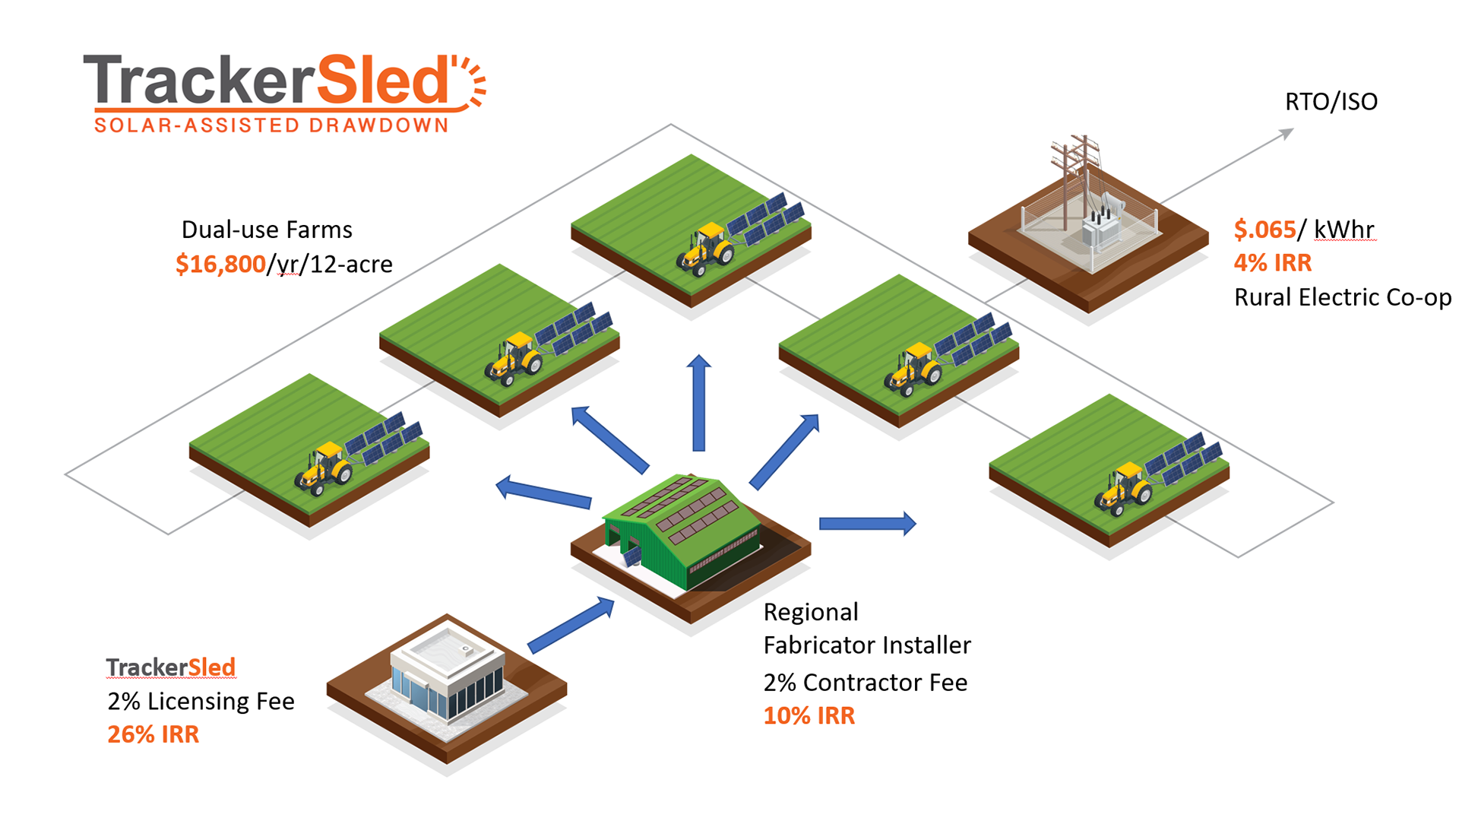
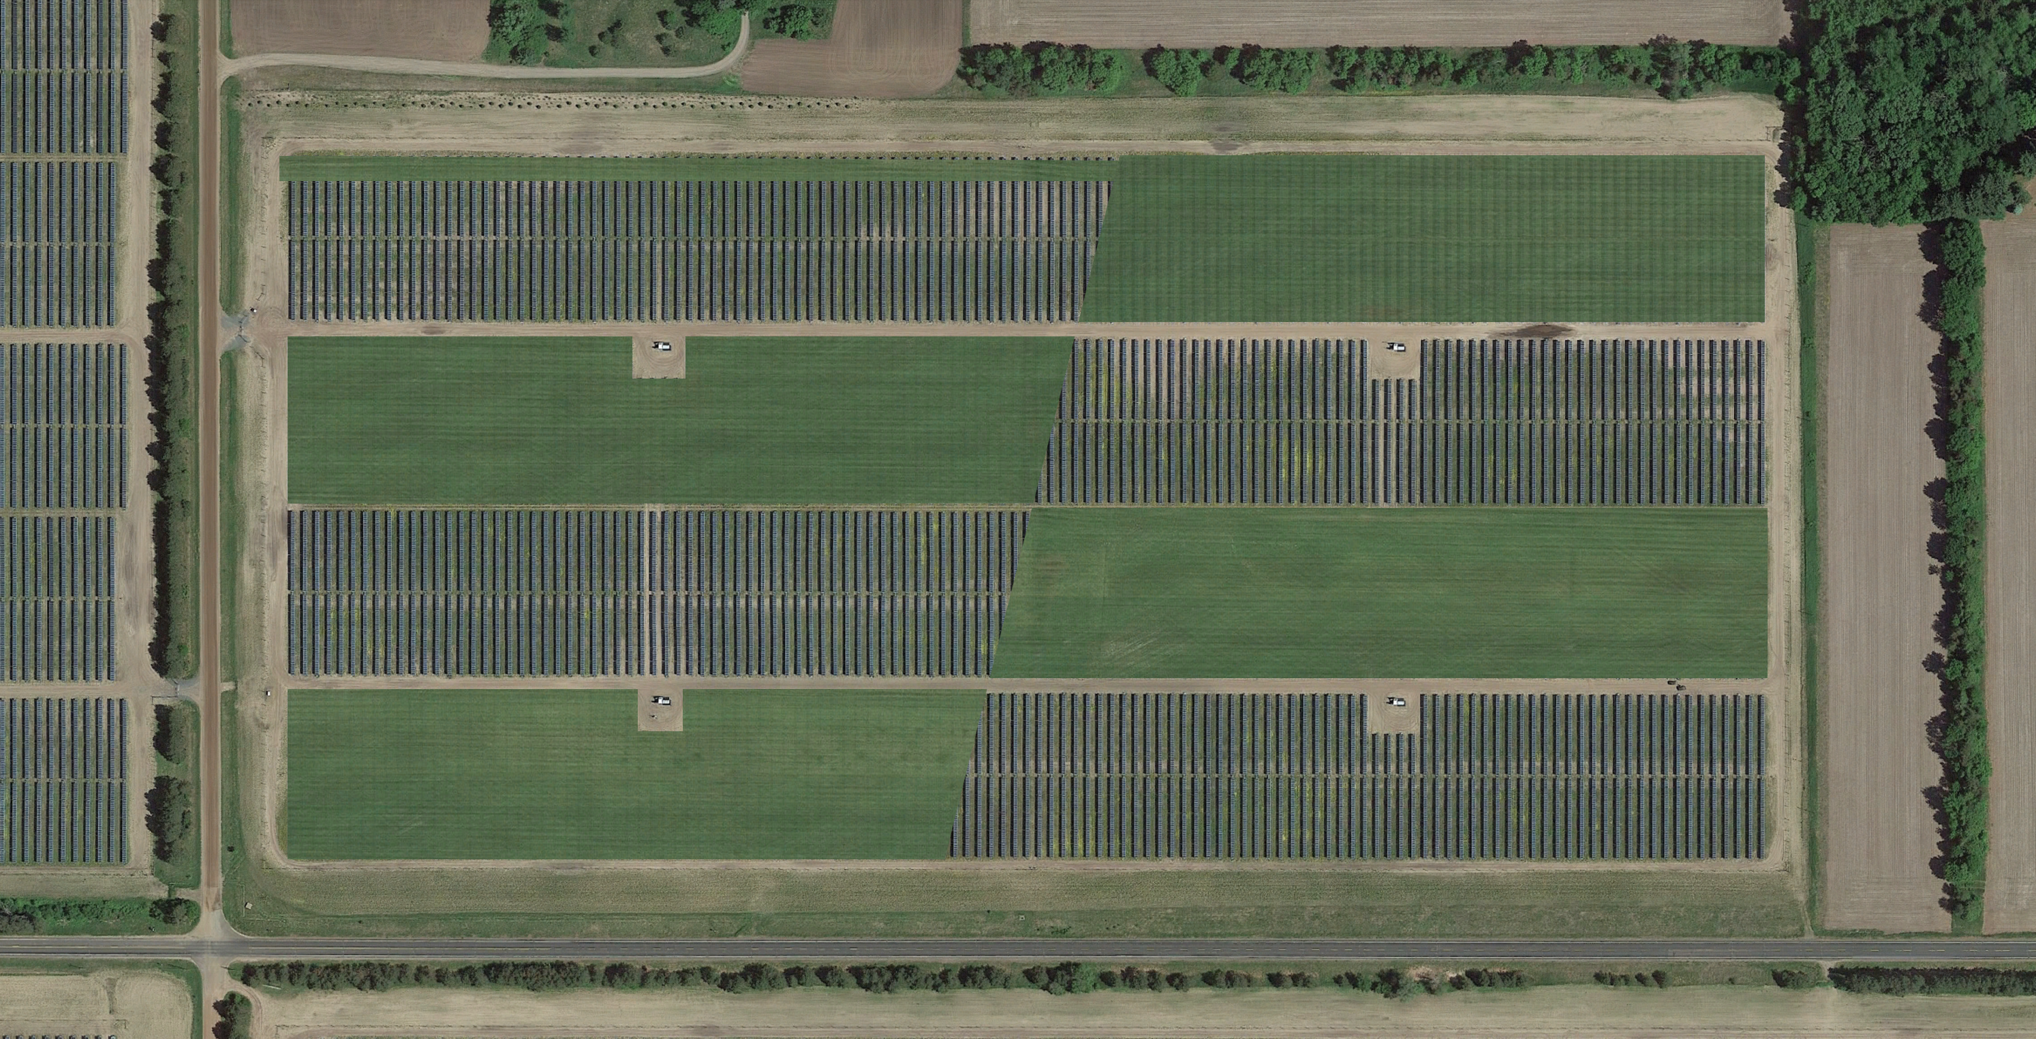
Converting Every US Farmer to Regenerative Practices with Solar
TrackerSleds enable the most scalable and affordable climate solution known today: drawing down carbon into agricultural soils. While generating energy and local jobs, rural electric co-ops will pay farmers to locate TrackerSleds on dual-use fields to supercharge the adoption of regenerative agriculture practices.
As farmers adopt these practices, depleted soils will sequester more carbon, making expensive ag chemicals unnecessary, increasing biodiversity, and dramatically reducing run-off. The single-axis PV trackers on TrackerSleds deployed by electric co-ops will harvest energy above deep-rooted plants that fix nutrients and carbon in the soil, reversing climate change. The TrackerSled ecosystem benefits People, the Planet, and Profit.
349 US cropland acres x 5% soil carbon increase = ¼ of all CO2 released since dawn of Industrial Revolution
TrackerSleds on Cover Crops
Cash Crops
Cash Crops
TrackerSleds on Cover Crops
TrackerSleds on Cover Crops
Cash Crops
Cash Crops
TrackerSleds on Cover Crops
Rotation #1
Rotation #2

