Slide 1
Solar Ambassador Prize Applicant Support Webinar
September 18, 2023
Notes:
Hi Everyone!
Thank you so much for joining today’s Applicant Support webinar for the Solar Ambassador Prize!
We are looking forward to diving deep into the Phase 1 requirements for submission and helping answer your questions regarding this prize.
My name is Caleigh Isaacks, and I am from the National Renewable Energy Laboratory. I am the Prize Administrator for the Solar Ambassador Prize.

Slide 2
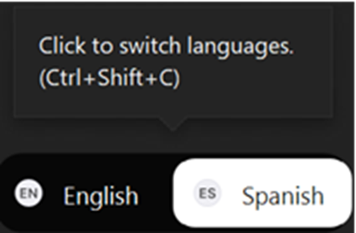
Spanish Interpretation
To Hear the Live Spanish Interpretation:​
Click the interpretation button
Select Spanish​
Interpretación en español
Para escuchar la interpretación en español: ​
Haga “clic” en el botón que dice “interpretation”
Seleccione “Español” ​
Notes:
To hear the live Spanish interpretation, click the interpretation button, and select Spanish. We have Rebeca on our call who will be helping us interpret this webinar.

Slide 3
Housekeeping
Two Options for Audio (select audio mode):​
Listen through your computer:​ Click the “up arrow” next to the “mute” button in the bottom left corner.​ Under “Select a Speaker,” click “Same as System.”​
Listen by telephone:​ Click the “up arrow” next to the “mute” button in the bottom left corner.​ Click “Switch to Phone Audio.”​
To Ask a Question:​
Select the “Q&A” button at the bottom of your screen and type in your question.​
Questions may be answered live, but all questions will be answered in writing on HeroX.
Having Trouble with the Webinar?​
Technical difficulties: Chat the webinar host for additional support.​
A video/audio recording of this webinar and the slide deck will be made available.
Notes:
A few items before we begin.
We have two options for audio. You can either listen through your computer or you can listen through your phone. The slide has directions for how to access each of these options.
If you have any questions during today’s webinar, please utilize the Q&A feature. We will be answering some questions live, but all questions will be answered in writing and will be posted onto HeroX.
If you have any trouble with today’s webinar, please feel free to chat the webinar host and panelists and we will try our best to assist you.
Lastly, we will also be posting a recording of today’s webinar along with the slides after today’s presentation onto HeroX.

Slide 4
Notice
None of the information presented herein is legally binding.
The content included in this presentation is intended for informational purposes only relating to the Solar Ambassador Prize Rules (“Prize”).
Any content within this presentation that appears discrepant from the “Prize” language is superseded by the “Prize” language.
All applicants are strongly encouraged to carefully read the Solar Ambassador Prize Rules and adhere to them.
Notes:
Please note that in today’s webinar, none of the information presented is legally binding, and the content included in this presentation is intended for informational purposes relating to the Solar Ambassador Prize Rules.
We strongly encourage all applicants to carefully ready through the Solar Ambassador Prize Rules before applying to the prize.

Slide 5
Topics
1
Solar Ambassador Prize Overview
2
Phase 1 Overview and Submission Requirements
3
Last Mile Community Map Overview
4
Q&A
Notes:
Today, we plan to cover the following:
- An overview of the Prize
- Phase 1 overview and what the submission requirements are
- An overview of the Last Mile Community Map
- A Q&A

Slide 6
Read the Rules
Official rules of the
Solar Ambassador Prize
are available online
https://americanmadechallenges.org/challenges/solar-ambassador
Or
Solar Ambassador HeroX Page > Resources Tab
Notes:
I’d like to re-iterate that you should read the rules before applying to the prize. You can find the official rules of the Solar Ambassador Prize on the HeroX page under resources or on americanmadechallenges.org. Rules are available in Spanish and English.

Slide 7
Solar Ambassador Prize Rules Overview
Notes:
Let’s dive into the Prize.

Slide 8
Prize Overview
The Solar Ambassador Prize is a $3.5 million prize.
The prize is designed for organizations in Puerto Rico to assist DOE in identifying, engaging, and assisting qualified households to apply for residential solar and battery storage inspections.
Notes:
So what is the Solar Ambassador Prize all about?
The prize is a $3.5M, 2 phase prize designed for organizations in Puerto to assist the Department of Energy in identifying, engaging, and assisting with intake processing of qualifying households for residential solar and battery storage inspections.
In Phase 1, organizations will submit their outreach and engagement plan that details how they intend to reach, engage, and assist the most vulnerable residents in Puerto Rico.
In Phase 2, Ambassadors will then implement their proposed plan and go out into the identified communities to assist households with their household intake application.

Slide 9
$3.5 Million in Funding
Prize Phase | Duration | Anticipated Number of Awards | Dollar Amounts
Phase 1: Design | 2 Months | An expected range of 10 -20 awards | $15,000 per winning competitor (total prize pool: $300,000)
Phase 2: Deploy | 5 months (anticipated) | Phase 2 household awards given to all active Ambassadors who sign up verified households. Additional Phase 2 incentive prize for Ambassadors | Per-household award: $100 per verified household Additionally, every Ambassador that signs up 750 verified households will receive a $10,000 incentive prize. (total prize pool: $3,200,000)
Notes:
As I mentioned previously, this is a $3.5 million dollar prize.
This table details the prize amounts for each of the two phases of the prize:
Phase 1: Winners will receive $15,000 per winner and the opportunity to participate in Phase 2
Phase 2: Winners will receive $100 per verified household that your organization signs up. Additionally, every Ambassador that signs up 750 verified households will receive a $10,000 incentive prize.

Slide 10
Who Can Participate?
The Solar Ambassador Prize is open to:
Community-based organizations (CBOs)
Nonprofit organizations
For-profit organizations
Organizations must be located in Puerto Rico
Individuals are not eligible to apply
Full eligibility can be found in the Official Rules
Notes:
The Solar Ambassador Prize is open to: Community-based organizations (CBOs), Nonprofit organizations, and For-profit organizations.
To be eligible for this prize, organizations must be located in Puerto Rico.
Please note that individuals are not eligible for this prize.
You can read more about the full eligibility in the Prize rules.

Slide 11
Phase 1: Design Overview and Submission Requirements
Notes:
Now more about what we are expecting for Phase 1.

Slide 12
Phase 1: Design Overview
The Phase 1: Design Contest is the first in this two-contest series and has a total of $300,000 in prizes.
Goal: Design to encourage organizations with existing connections to vulnerable communities in Puerto Rico to bolster current engagement by creating plans that include educating homeowners on residential solar and storage and benefits of participation in PR-ERF.
Design Contest Prizes
Up to 20 awards Each Phase 1 winner will receive a $15,000 cash prize. $5,000 will be given to selected winners The remaining $10,000 will be given after Ambassadors complete the required training.
Notes:
Phase 1 is the first of the two Solar Ambassador prize phases and will award up to 20 competitors with $15,000 each in cash prizes.
The goal of Phase 1 is to encourage organizations with existing connections to vulnerable communities in Puerto Rico to bolster current engagement by creating plans that include educating homeowners on residential solar and storage and benefits of participation in PR-ERF.
Selected winners will $5,000 upon being notified of selection, and they will receive the remaining $10,000 after completing the required training in November.

Slide 13
Phase 1: Design Logistics
Important dates
Open: July 31, 2023
Submission deadline: September 25 at 5 p.m. AT/ET
Winner announcement: October 2023 (anticipated)
Phase 1 Required Training (For selected Phase 1 winners only): November 2023 (anticipated)
Read the Rules
The official rules can be found at: herox.com/solarambassador
Enter your Phase 1 submission
The Phase 1 submission form can be found on HeroX by clicking on:
Notes:
The Phase 1 contest is open now and the submission deadline is September 25 at 5pm AT/ET.
We are anticipating a winner announcement around late October.
Once Phase 1 winners are selected and announced, those selected Phase 1 winners be required to attend a training in November in order to move onto Phase 2.
The official rules and Phase 1 submission form can both be found on HeroX, which is our prize platform

Slide 14
What to Submit for Phase 1: Design
Cover page (selected questions public)
Narrative (5,000 words max)
Applications may be submitted in English or Spanish.
Notes:
Now that you know where to upload your phase 1 submission materials, we’re going to talk the required Phase 1 submission materials including the:
Cover Page and the Narrative.
Your submissions may be submitted in English or Spanish.

Slide 15
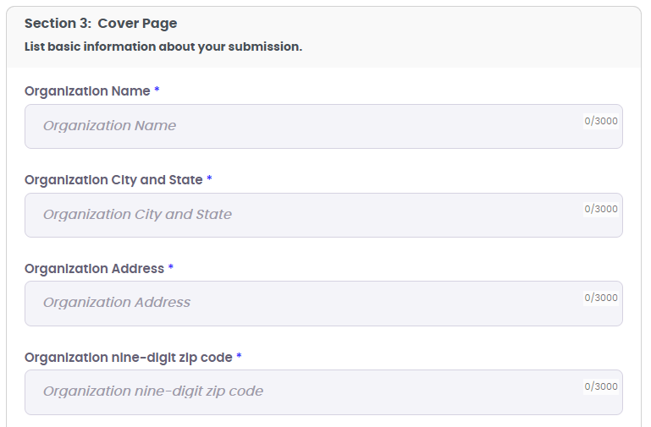
Cover Page
To be completed via HeroX
List basic information about your submission:
Submission title*
Organization name*
Organization city* and state*
Organization address
Organization nine-digit zip code
Organization website URL*
Register number
Point of contact information (name, email, phone)
Starred (*) elements will be made public on HeroX.
Notes:
The first requirement is the cover page. This information will be collected via the HeroX submission form and is not a separate document upload. This information will be checked upon submission for accuracy.
Please note that the starred elements will be shared publicly after winners are announced.

Slide 16
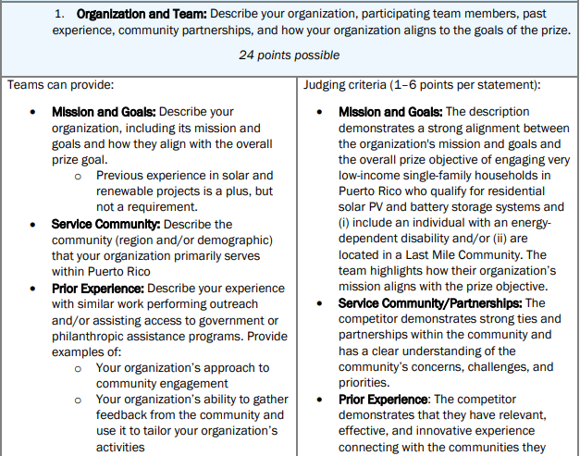
5,000 word maximum
Narrative
Answer each of the questions in the two areas:
Organization and Team: Describe your organization, participating team members, past experience, community partnerships, and how your organization aligns to the goals of the prize.
Phase 2 Strategic Plan and Community Engagement Approach: Your plan to engage and work with communities to perform program outreach, education, and complete intake processing of qualified Puerto Rican households for residential solar.
Notes:
The final submission requirement is the narrative which is the heart of your Phase 1 submission.
For the narrative we ask that you respond to a series of questions and prompts within two areas:
Organization and Team: Describe your organization, participating team members, past experience, community partnerships, and how your organization aligns to the goals of the prize.
Phase 2 Strategic Plan and Community Engagement Approach: What is your plan to engage with and work with communities to perform program outreach, education, and complete intake processing of qualified Puerto Rican households for residential solar?
You will have 5,000 words to answer all two areas which is approximately 10 pages of text.
In the rules document, you will find additional detail on the narrative starting on page 11.
In your narrative, please make sure you are answering each of these questions. Submissions that do not answer these questions are going to have a lower chance of being selected for Phase 2.
Additionally, on the right column, you can see what the judging criteria is and how your submission will be scored. You can utilize this judging criteria as a guide to ensure you are answering the questions needed.

Slide 17
Required In-Person Training
Winners of Phase 1 will be required to attend this training in order to move forward to Phase 2.
In-person opportunity in Puerto Rico for prize teams to review key information and tools for Phase 2 deployment.
Ambassadors will receive a certificate of completion and will meet with a mentor from DOE to discuss final deployment plans and verify subject competency.
Fall 2023 – Date TBD
Topics covered during the training:
Solar and Storage 101
Structural Eligibility
Information Collection
Technical Training
Communication Flow
Community Engagement
Notes:
After announcing Phase 1 winners, selected Ambassadors will be required to attend this in-person training in November. At least one individual from your organization will need to attend this training in order to move forward to Phase 2.
This will be a mandatory in-person opportunity in Puerto Rico is for teams to review key information and tools for Phase 2 deployment. The following topics will be covered:
• Solar and Storage 101
• Structural Eligibility
• Information Collection
• Technical Training
• Communication Flow
• Community Engagement
After training is complete, Ambassadors will receive a certificate of completion and will meet with a mentor from DOE to discuss final deployment plans and verify subject competency. If any changes
are made to a Solar Ambassador’s deployment plan, it will be reviewed before Phase 2 deployment begins.

Slide 18
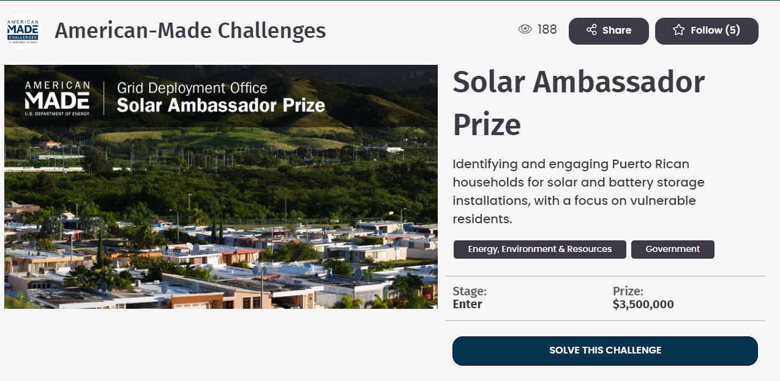
HeroX Live Demo
Sign up for the prize and read the official rules document at: https://www.herox.com/solarambassador
Notes:
And now, we’re going to take a moment here to do a live walk through.
We’ve dropped the link to HeroX in the chat, and I encourage each of you to follow along with me as I show you how to sign up for the prize and show you where to find key information about the prize.

Slide 19
Last Mile Community Map Overview
Notes:
As part of your narrative, you will need to identify the geographic region from the Last Mile Community Map in which you would like to conduct your outreach in.

Slide 20
Last Mile Community Map
What is it?
Competitors can utilize the Last Mile Community Map of already identified Last Mile Communities to describe the specific regions and/or demographics within Puerto Rico that will be targeted in Phase 2 if the team is a Phase 1 winner.
Describing the geographic focus is part of a competitor’s Phase 2 Strategic Plan and Community Engagement Approach and is a requirement of the Narrative.
How to use it
Navigate to HeroX for the link: https://www.herox.com/solarambassador/resource/1394
Find a municipality and corresponding Block ID numbers:
Filter the map by the municipality of interest (i.e., the community your organization serves or the area your organization would like to include in its outreach plan).
Identify the selected municipality or municipalities in your outreach plan.
Competitors may identify partial regions of a municipality as part of their outreach plan. This can be done by listing Census Block IDs of the desired areas of interest.
Block ID will be listed as user hovers over region.
Search for a location by address or latitude/longitude coordinates:
Enter an address or latitude/longitude coordinates in the search bar. A blue pin will pop up at that location.
Notes:
The Last Mile Community Map is a tool that your submission can utilize to describe the specific regions and/or demographics within Puerto Rico that will be targeted in Phase 2, if selected as a Phase 1 winner.
To find these communities, first navigate to HeroX at the following link: https://www.herox.com/solarambassador/resource/1394
Then find a municipality and the corresponding Block ID numbers by:
- Filtering the map by the municipality of interest
- If you serve a certain community and want to find out they are in the Last Mile Community, filtering the municipality is the easiest way to find the community.
- After you filter, you can identify the selected municipalities you want to reach in your outreach plan.
- You may identify partial regions of a municipality, multiple municipalities as part of your outreach plan.
- To identify a partial region of a municipality, you can list the census Block ID of your desired interest.
- The Block ID is identified when you hover over a region.
- The Block IDs should be listed in your submission.
- You can also find a community by entering an address or entering in latitude/longitude coordinates in the search bar. You will see a blue pin drop at the location.

Slide 21
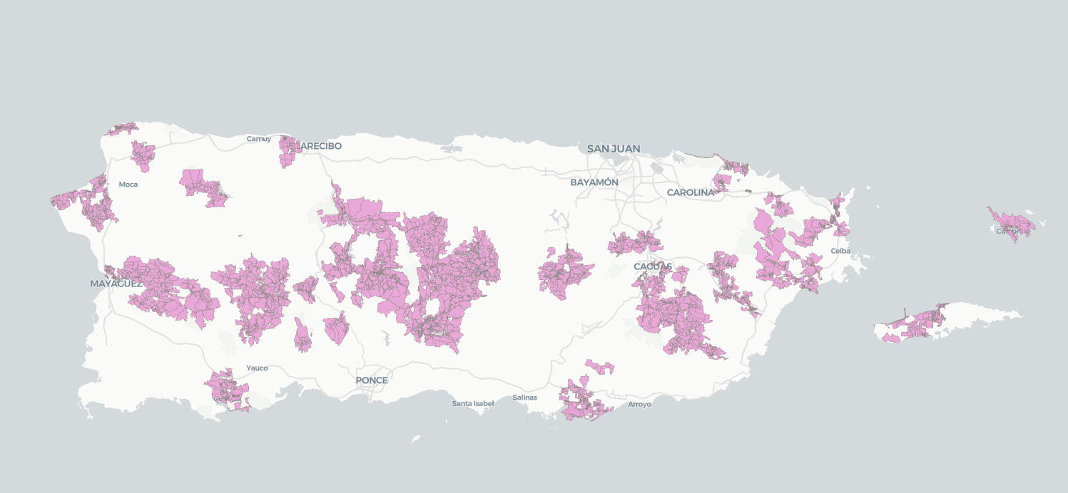
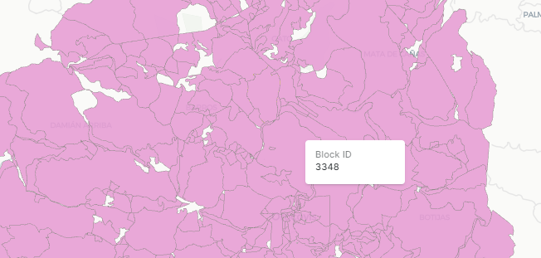
Last Mile Community Map
Notes:
Here is a screenshot of the Last Mile Community Map. The pink areas are where we are targeting for this Prize. You can see in the right picture, a close up with a Block ID. I’ll also do a quick demo of the map so you can see.

Slide 22
Questions?
Notes:
Now we will move onto the Q&A portion of the webinar. These questions have been asked prior to the webinar.
If you have additional questions, please type them in the Q&A function. We will provide a written response after the webinar, and will post it to HeroX.

Slide 23
Can we see the household intake application that the community members will fill out in Phase 2?
The Household Intake Application will be shared with Phase 1 awardees during the mandatory Solar Ambassador Training in November. Solar Ambassadors will be trained on how to complete the form with homeowners.

Slide 24
If the number of households exceeds 30,000, what is the procedure?
The total funding across the Solar Ambassador Prize is enough funding to compensate Ambassadors for the first 30,000 verified households. The Prize Team will communicate with Ambassadors during Phase 2 to let them know the total number of verified households they will be credited with from their submitted household applications.

Slide 25
Will the system be provided, installed, and maintained at no cost to the household?
Funding under the PR-ERF FOA will be used primarily to defray system costs for eligible beneficiaries. DOE anticipates that beneficiaries will be responsible for some portion of system costs. The amount and form of these costs will be determined as part of the Phase 1 planning process with PR-ERF awardees. Please refer to the PR-ERF FOA for additional details regarding the Phase 1 planning process. Rooftop solar systems will not be totally free for the beneficiaries receiving them under this program. However, these systems will help the average qualifying family save money on their electricity bill. Some of those savings will be used for long-term maintenance payments on the system to keep them up-and-running for decades.

Slide 26
Will an ambassador be allowed to recruit more than 750 applicants?
Ambassadors may recruit more than 750 households at the approval of the Prize Administration Team.

Slide 27
Do apartments qualify as households for the Solar Ambassador Prize?
Not right now. DOE is pursuing a multi-phased approach with the $1 billion Puerto Rico Energy Resilience Fund. This first funding opportunity announcement (FOA) focuses on single-family residential rooftop solar PV and battery storage solutions. The Solar Ambassador Prize is a complementary effort to this first FOA. In addition, a second FOA is expected to be released next year and is likely to focus on community-level resilience investments, which may include solutions for multifamily buildings.

Slide 28
How were Last Mile Communities selected?
DOE used detailed sociodemographic data and power outage data to determine which census blocks in Puerto Rico experience the most frequent and prolonged power outages. These electrically vulnerable areas are called Last Mile Communities. You can find the map here: Interactive Last Mile Community Map

Slide 29
What is the criteria for a qualified Puerto Rican household?
Beneficiaries of the program include low-income single-family households located in a Last Mile Community, or low-income single-family households with an energy-dependent disability.

Slide 30
Will engineers or architects certify these households or how is that done?
Once a household is verified, it will be passed to awarded solar companies to design and install a solar PV and battery storage system. DOE will allow some of the funding to make a home “solar ready”, such as certain rooftop repairs and electrical improvements.

Slide 31
Can individual people of organizations apply for the Solar Ambassador Prize?
A single individual is not eligible for the prize. Only organizational entities are eligible. Employees of an organization are able to join their prize team as collaborators on HeroX, where they can follow the prize and contribute to their associated team’s application.

Slide 32
How big does a team need to be in order to submit an application for Phase 1?
The applicant team should include enough individuals to complete the work as asked for in the prize rules. Any individuals participating must be associated with an applying team.

Slide 33
What activities must a Solar Ambassador perform for the in-person intake?
Solar Ambassadors must have the ability to perform in-person outreach in priority communities. This will include door-to-door engagement with homeowners. This may also include the hosting of in-person community engagement events. Applying teams must have a robust and realistic outreach plan for in-person homeowner engagement that fits the needs of priority communities.

Slide 34
Are Solar Ambassadors required to have identified households before applying?
No, Ambassadors are not required to identify households before applying. Ambassadors will choose regions from the Last Mile Community Map where they would like to implement their proposed plan. You can find the Last Mile Community Map here: https://www.herox.com/solarambassador/resource/1394

