Slide 1
This webinar will be recorded.
Department of Energy Office of Technology Transitions
EPIC Round 3
Phase 1: Informational Webinar

Slide 2


Katherine Harsanyi
Commercialization Program Manager, DOE OTT
Eli Cain
National Renewable Energy Laboratory
Program Manager

Slide 3
Agenda
1
American-Made Overview
2
OTT & EPIC Round 3
3
Submission Elements and Scoring
4
HeroX
5
Next Steps

Slide 4
Housekeeping
This webinar will be recorded.
This webinar is being recorded and will be available on HeroX.
Questions?
  To submit a question, please type it into the Q&A box on the right-hand side of your screen next to the chat box. Will post answers to all questions we receive to HeroX as quickly as possible.
Technical Issues:
  If you experience technical issues, please check your audio settings under the “Audio” tab.
  If you continue experiencing issues, direct message the host

Slide 5

Fast track your ideas for the clean energy revolution
$200M
55+
400+
in cash prizes and support
prizes
Network members

Slide 6
Office of Technology Transitions
Overview

Slide 7
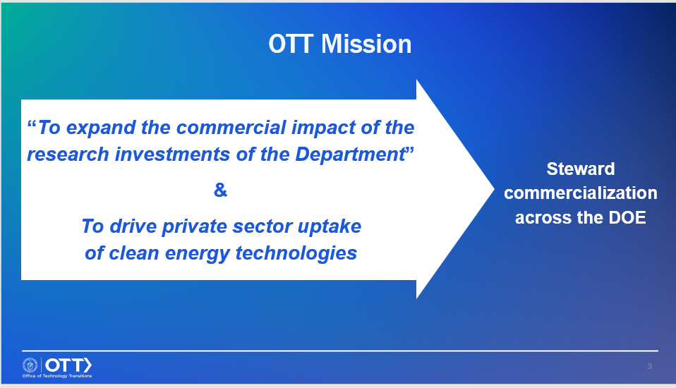
Hold for OTT Slides

Slide 8


EPIC Over the Years
2020/21 EPIC Prize Round 1
2021/22 EPIC FOA
2022/23 EPIC Prize Round 2
2023/24 EPIC Prize Round 3
8

Slide 9
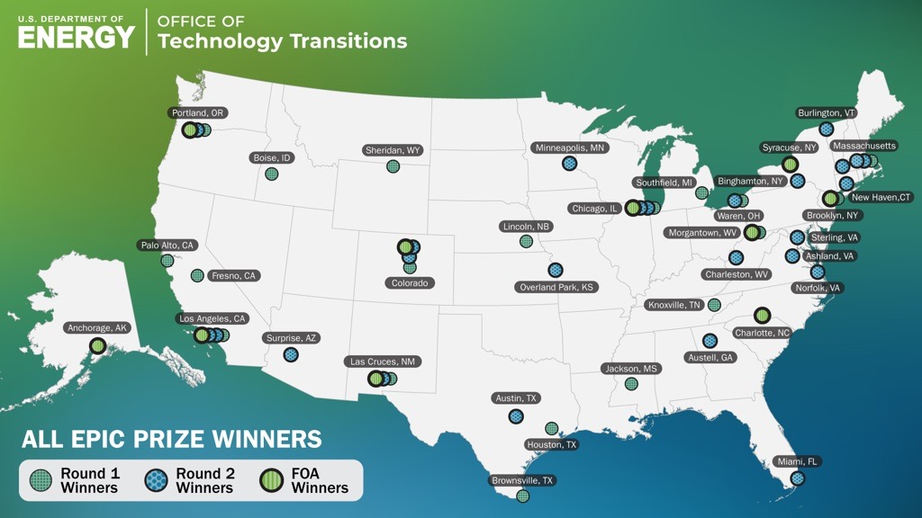
EPIC Program Overview

Slide 10
EPIC Round 3
Overview

Slide 11
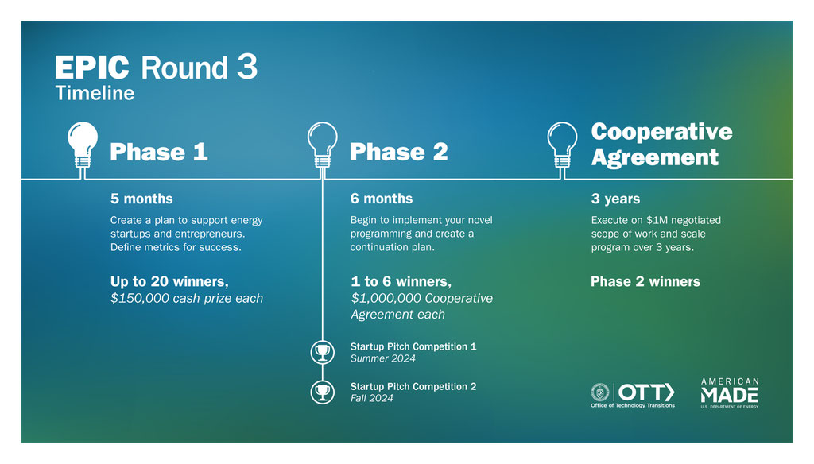
What is EPIC Round 3?

Slide 12
Startup Pitch Competitions
During EPIC Round 3, we will hold two startup pitch competitions
Any EPIC winner (Round 1, 2, 3, or FOA) can nominate a startup
Startups will compete for their share of $80,000 (per pitch competition)
The incubator that nominates the winning startup will receive $25,000
Full instructions for how to nominate a startup, startup eligibility, and other details, can be found in the Official Rules document.

Slide 13
EPIC Round 3
Program Details

Slide 14

Read the Rules
Official Rules for EPIC Round 3 are online, on the HeroX page
EPIC Round 3 Official Rules

Slide 15
Program Requirements
Across all phases of EPIC Round 3, competitors must address the following Program Requirements:
Create New Programming
Support Startup Creation
Build Regional Partnerships
Impact Areas
Specific submission requirements vary phase by phase

Slide 16
Program Requirements
Across all phases of EPIC Round 3, competitors must address the following Program Requirements:
Impact Areas—Submissions must address at least one of the following
  Diversity, Equity, Inclusion, and Accessibility
  Rural and Disadvantaged Communities
  Lab-to-Market
  Sector-Specific-Support
  Other High-Impact Theme
Specific submission requirements vary phase by phase

Slide 17
Eligibility
This prize is open to private entities and academic institutions, provided they meet these requirements:
  Private entities must be incorporated in and maintain a primary place of business in the United States with majority domestic ownership and control (foreign entity participation waivers are available);
  Academic institutions and non-profit entities must be based in the United States
Programming proposed must have an emphasis on supporting hard-tech startups
National Laboratories are not eligible to compete as the lead applicant. But, they may support teams in the competition as long as normal lab partnership procedures are followed
Only winners of Phase 1 are eligible to complete in Phase 2
Only winners of Phase 2 will be selected to negotiate a cooperative agreement
See list of ineligible competitors in the Official Rules document
Notes:
.

Slide 18
Important Dates
Phase 1
February 9, 2024 5pm EST: Phase 1: Submission Deadline

Slide 19
Phase 1 Requirements
EPIC Round 3

Slide 20
Phase 1 Submission Package
Summary Slide (will be made public)
Cover Page
Submission Narrative
  Organization Overview
  Region and MVP Overview
  New Elements and Focus Area
  Implementation Plan
Success metrics table
Letters of Commitment and Support
Full details on the Phase 1 submission package can be found in the Official Rules document

Slide 21
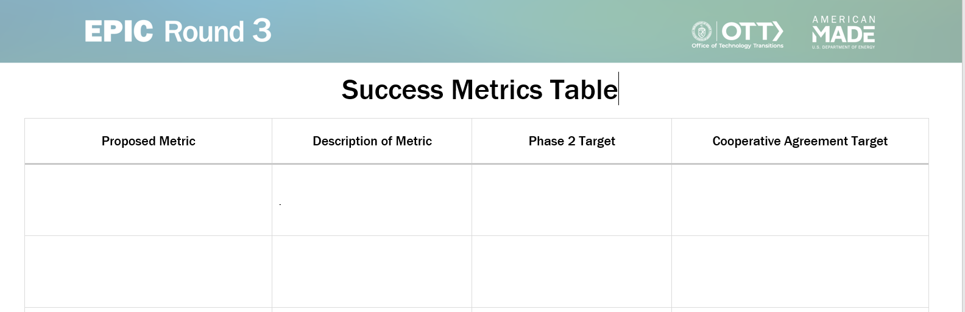
Success Metrics Table
Success Metrics Table template can be found in the Resources tab in HeroX.

Slide 22
Phase 1 Scoring
Criteria | Weighting
Team Composition, Capability, and Experience | 30%
MVP Design | 30%
Implementation Plan | 30%
Reviewer Recommendation | 10%

Slide 23
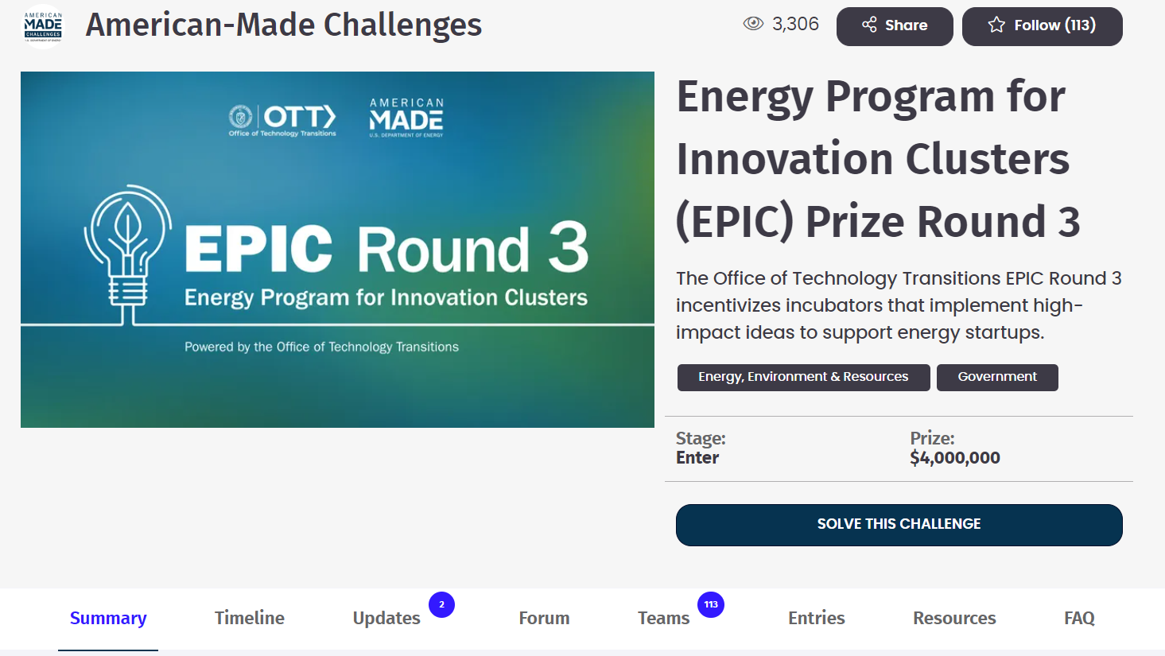
How to Apply

Slide 24
What’s Next?
Follow the challenges on HeroX:
    https://www.herox.com/EPICRound3
Read the rules:
    EPIC Round 3→ Resources Tab
Talk to your stakeholders!
Apply by February 9, 2024 5pm EST

Slide 25
Thank you!

