Slide 1
Power at Sea Prize Overview
Webinar November 29, 2023

Slide 2
This webinar is being recorded.
Please post your questions in the Q&A.

Slide 3
Agenda
Water Power Technologies Office (WPTO) Overview
Powering the Blue Economy (PBE)
Power at Sea Prize Overview
Goals
Timeline
Challenge Area
What to Submit
How to Submit (HeroX)
Thank you & Questions

Slide 4
Water Power Technologies Office (WPTO)

Slide 5
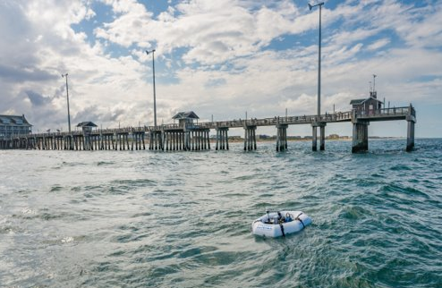
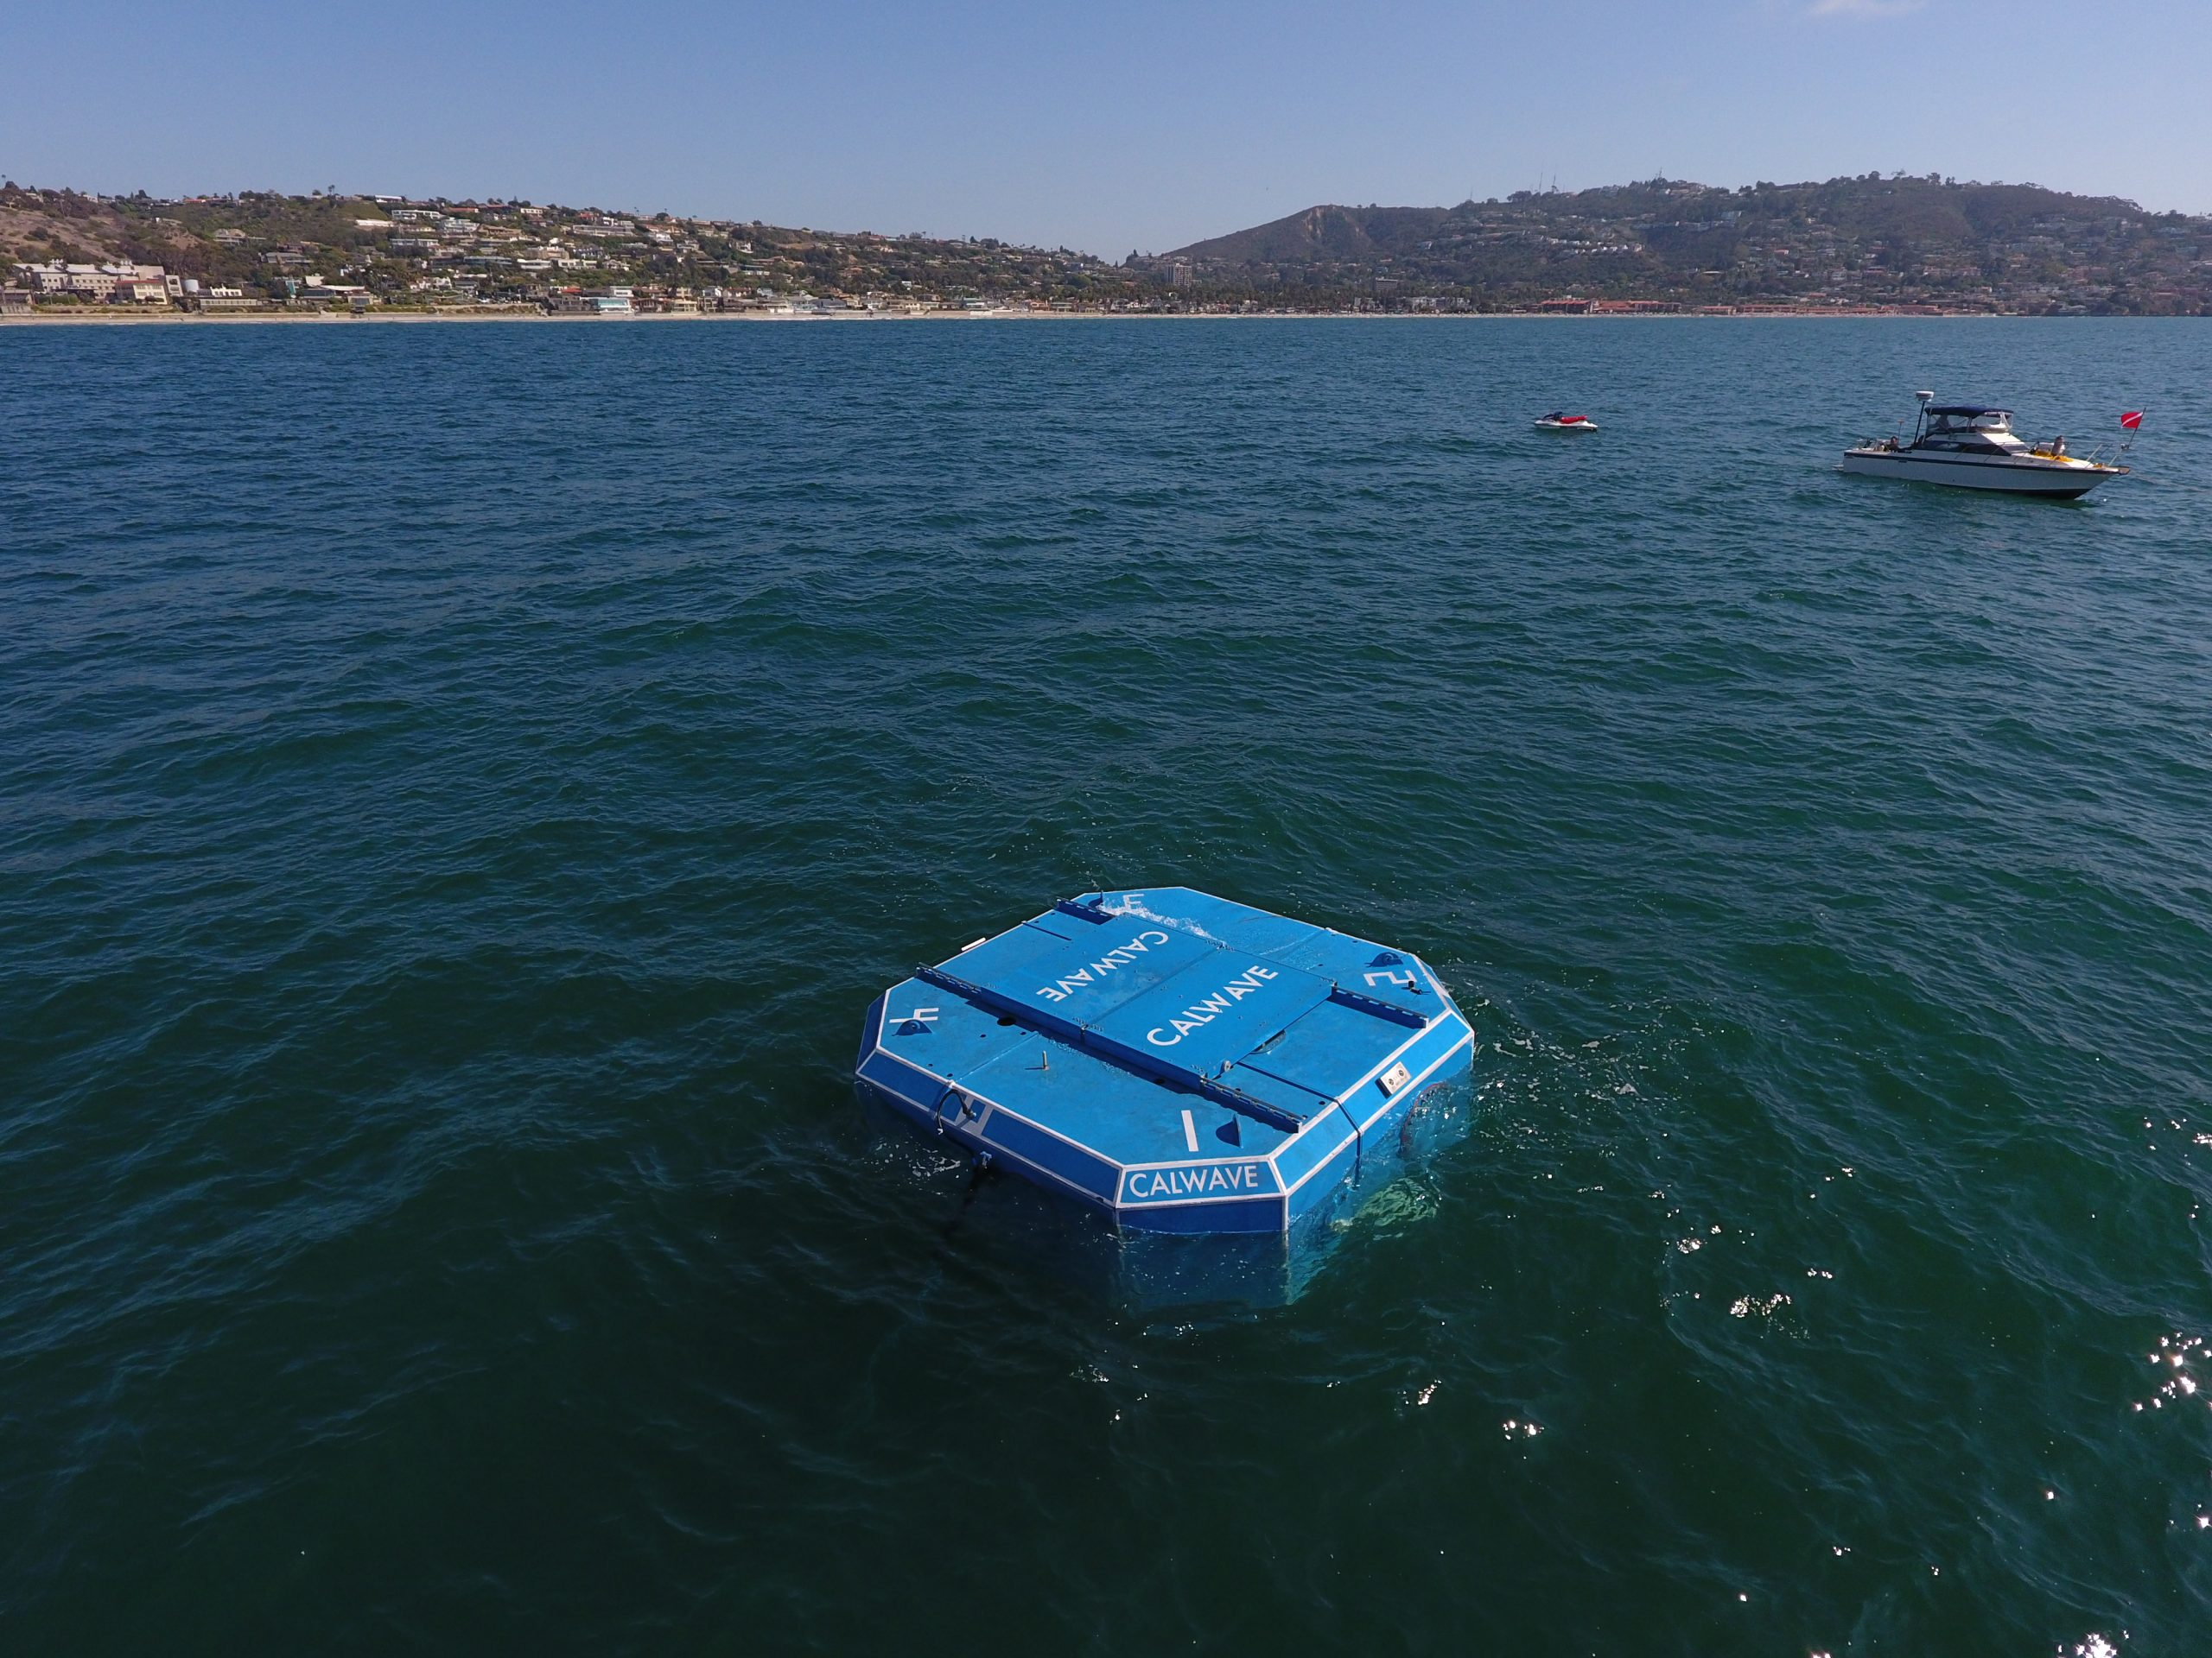
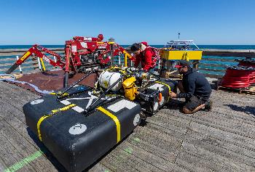
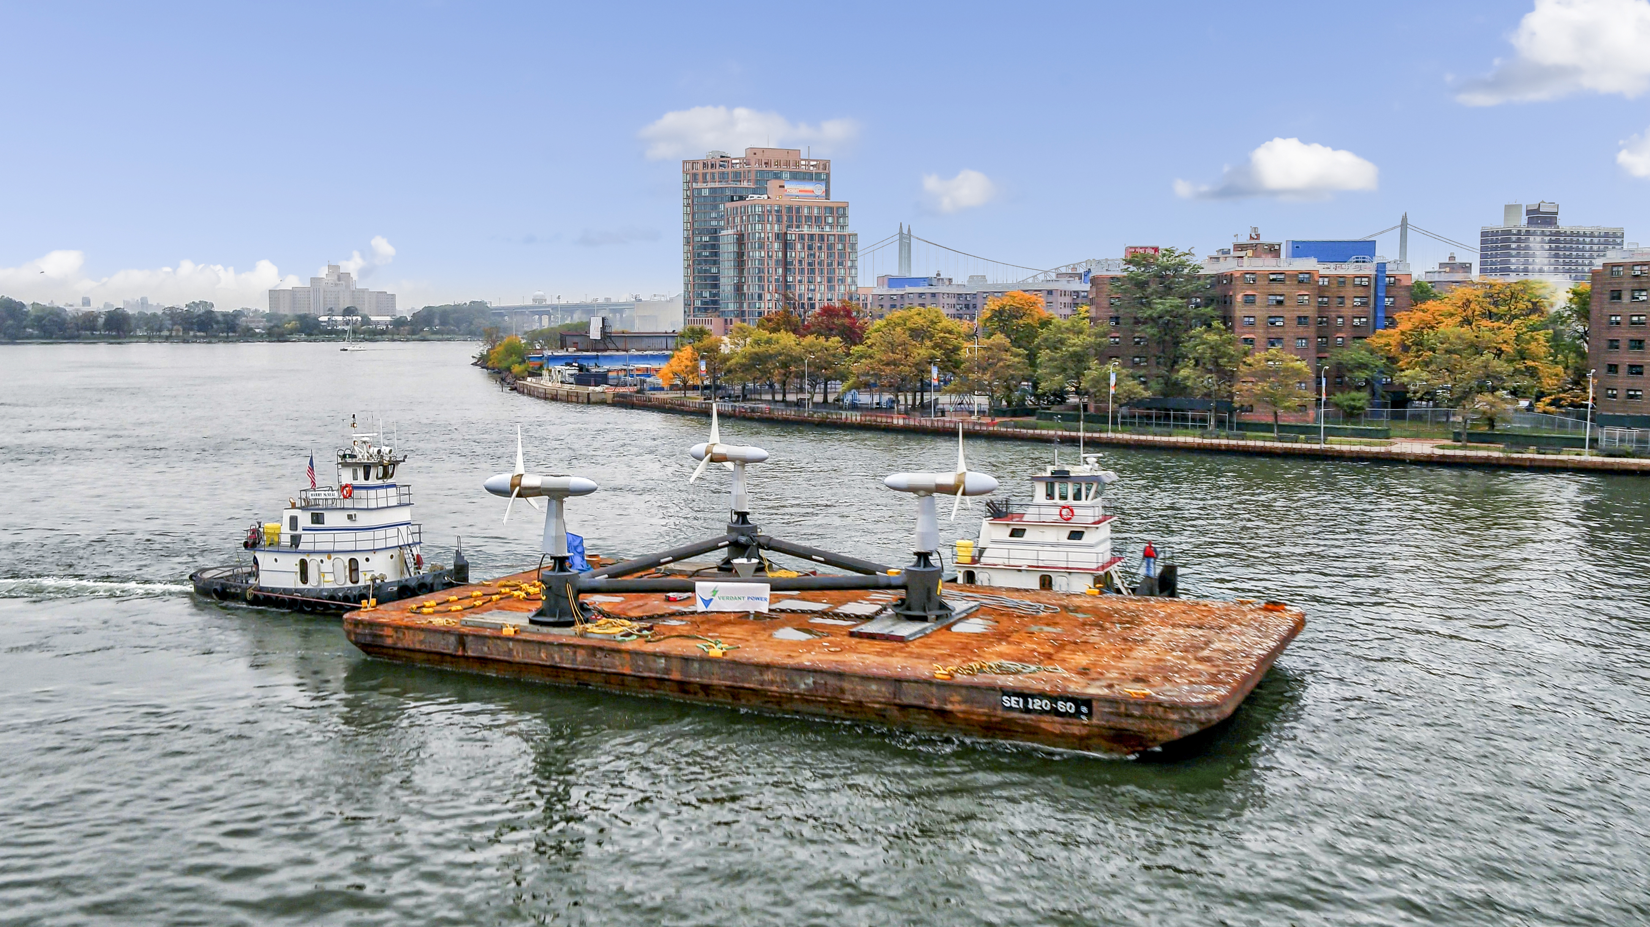
WPTO Marine Energy Program Mission
Harness energy from the world’s oceans
Waves
Tides
Ocean Current
River Current
Thermal Gradients
Salinity Gradients
Pressure Gradients
NREL HERO WEC – Nags Head, North Carolina
CalWave – San Diego, California
Oneka – Nags Head, North Carolina
Verdant Power – New York, New York

Slide 6
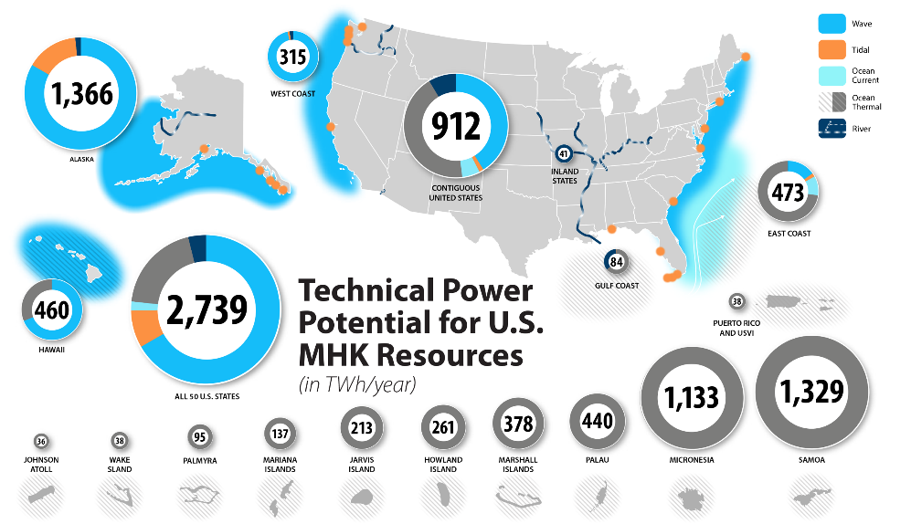
The Size of the Marine Energy Resource is Significant
Equivalent to 57% of electricity generated in the U.S. in 2019
https://www.energy.gov/eere/water/articles/marine-energy-united-states-overview-opportunities

Slide 7
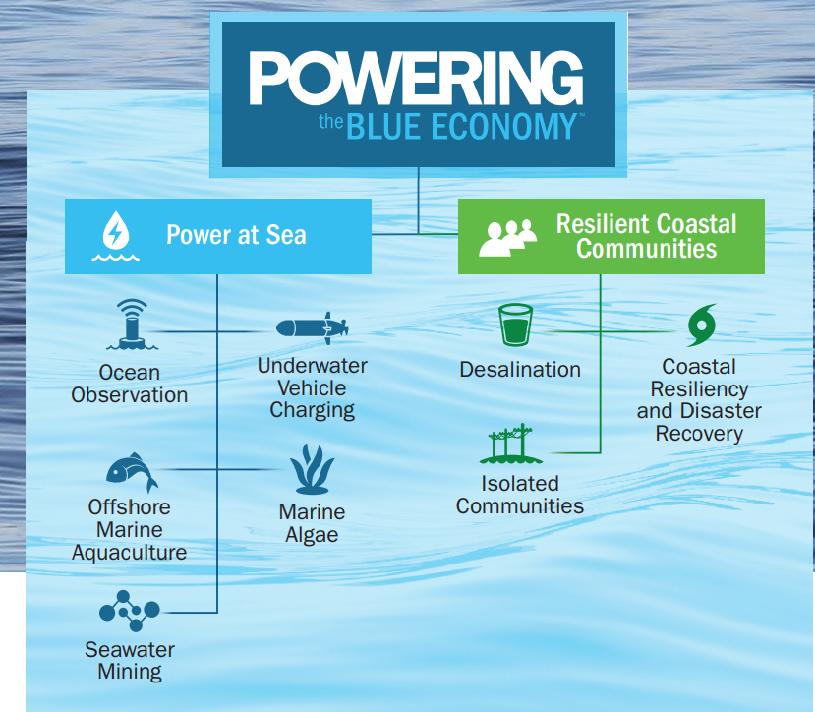
Powering the Blue Economy
Potential market opportunities where marine energy may hold a unique value proposition to meet the energy needs of the blue economy.
Technology attributes of marine energy beneficial to many blue economy markets:
Ability to provide both electrical and mechanical power
Minimal surface expression improving storm survivability
Opportunities for co-design and integration with other infrastructure
Ability to leverage existing maritime supply chains
Represents a new strategic focus for the marine energy program, supporting opportunities uniquely suited to marine energy attributes
mCDR

Slide 8
The Next Powering the Blue Economy™ Prize:
Power at Sea

Slide 9
Prize Goals
Prize Goals
Engage and cultivate a community of new and existing participants in marine energy to introduce new, creative minds to Powering the Blue Economy and the marine energy field, fostering the development of new concepts and lessons learned.
Identify new, innovative, and feasible marine energy concepts that have a high likelihood of providing power at sea in the near term to accelerate the commercialization of the nascent marine energy industry.
Introduce competitors to WPTO and government funding mechanisms and prepare them to compete technically and financially for future funding opportunities both within and beyond DOE

Slide 12
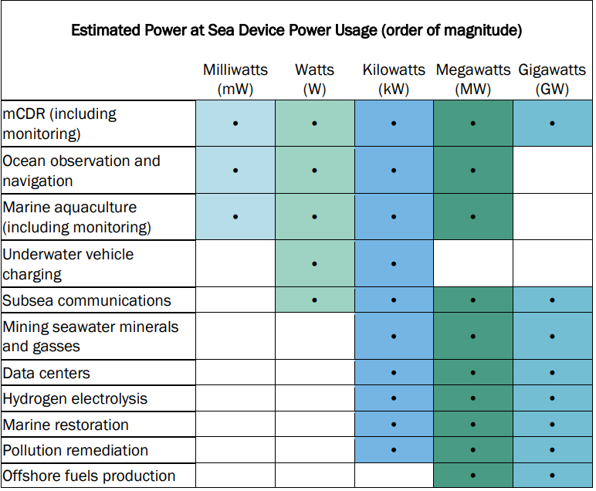
Blue Economy Applications
Competitors must propose a tangible system, subsystem, or component that receives more than or equal to 50% of energy needs from one of the following marine energy resources: wave, tidal, ocean current, river, salinity gradients, or thermal gradients to power systems at sea.
Competitors will be required to choose one challenge area to address from the following list of specific blue economy integration challenges (listed in alphabetical order) that can be addressed in the marine energy concepts submitted to this prize (on next slide).
This table defines applications that could use power at sea.
Applicants must identify one of these examples or another application in their proposal.

Slide 13
Blue Economy Integration Challenge Areas
Access | How does your marine energy solution help to reduce the high cost or limited opportunities for service, maintenance, and/or intervention for at-sea blue economy applications?
Deployment Duration | How does your marine energy solution improve the deployment duration of at-sea blue economy applications?
Energy Storage | How does your marine energy solution improve the capabilities and duty cycles currently limited by battery capacity, especially considering that batteries may account for most of sensor volume and weight?
Environmental/Ecological Impact | How does your marine energy solution minimize the negative effects of interactions with local flora and fauna at the deployment site?
Harsh Operational Conditions | How does your marine energy solution minimize or otherwise address operations in challenging conditions like violent storms, strong currents, strong pressure (i.e., for subsea applications), corrosive media, and unwanted growth of marine organisms?
Hybridization with Other Renewable Energy Resources | How does your hybrid solution utilize marine energy to address power gaps caused by intermittency of other non-marine renewable energy resources like solar and wind due to seasonality and changing weather patterns?
Suitability of Power | How does your marine energy solution match power generation to power needs to maximize efficiency?

Slide 14
Submission Requirements
Summary Slide
Public
Accept/Reject
Competitors will identify basic information about their submission, This information should not exceed a single page. Should include: Title Competitor team name and contributing team member names Organization Challenge area Blue economy application Short description of the proposed plan, activities, and use of the prize funds. Link to the 3-minute video pitch.
3-Minute Video Pitch
Public
Scored
Competitors will produce a 3-minute video that will help the reviewers and public understand the competitor, the concept, and the relevant market the technology intends to serve. Competitors should be creative and convey information in a fun and engaging way. Reviewers will focus on the content, not the quality, of the video production, as this is intended to primarily help introduce someone to the technical concept.
Technical Narrative
NOT Public
Scored
Competitors will write a detailed narrative describing the solution. There is a template available. The total page count must not exceed 10 pages. Acceptable fonts and margins are listed in the official rules document. The narrative may also include up to five supporting visualizations or graphics.

Slide 15
Scoring and Criteria
All scored submission components will be scored on how well the competitor addresses the statements in each criterion; each statement will be scored by reviewers on a 0–5 scale.
Scoring Criteria: 3-Minute Video and Technical Narrative
Suggested Content Competitor Provides: Example: An introduction to the team | Each Statement Scored on a 0–5 Scale: Example: A description of the team and their relevant experience, qualifications, and capabilities.
On the left-hand side are suggested content you could provide to address the scored statements. | On the right-hand side are the exact scoring statements that reviewers will use to score your submission.

Slide 16
Scoring and Criteria
Scoring Criteria | Number of Scored Statements | Total Possible Points
3-Minute Video Pitch | 4 | 20
Technical Narrative | 14 | 70
Criterion 1: Identification of Application and Challenge Area | 3 | 15
Criterion 2: Proposed System, Subsystem, or Component | 6 | 30
Criterion 3: Team Engagement and Planned Development | 5 | 25
TOTAL | 18 | 90

Slide 17
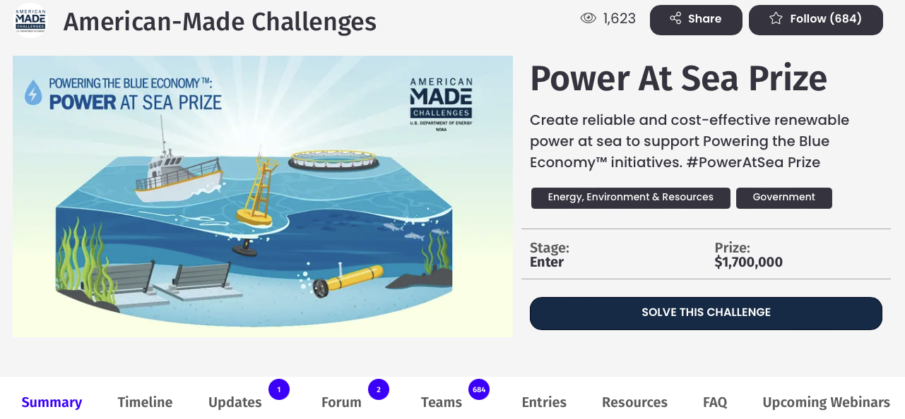
HeroX Platform
Share & follow
the prize
Submit
your idea!
Stay up-to-date
Communicate with the prize administration team
Access valuable resources like the rules and templates!
Register for upcoming Webinars
Build a team

Slide 18
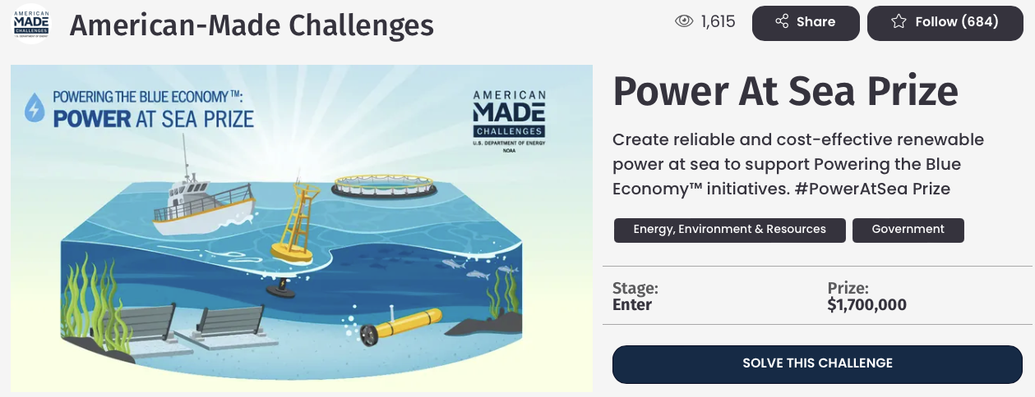
Register and Compete
Visit the HeroX prize page: https://www.herox.com/PowerAtSea
Choose “Solve this Challenge” (indicates your interest in competing; it is not a commitment—yet)
Sign in or create a HeroX account
Agree to the Terms of Use
Confirm your email address
Accept the Challenge-Specific Agreement
Indicate “Would you like to compete as a team?”
Submit Final Submission materials prior to July 26, 2024

Slide 19
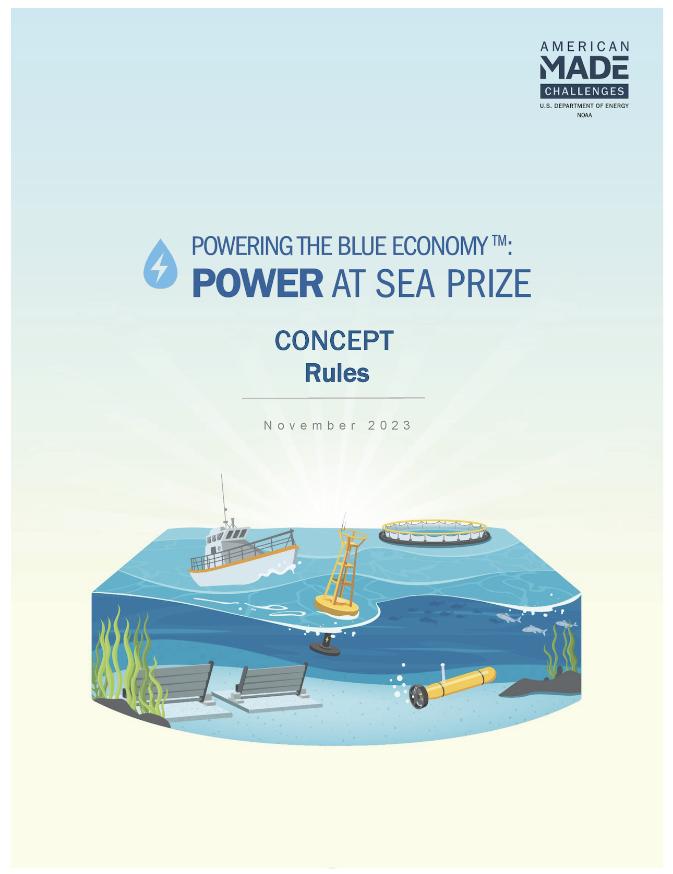
Read the Rules
Topics covered in today’s presentation can all be found in the Official Rules Document.
For a more in-depth look at these topics, please read the rules document, which is available here: https://americanmadechallenges.org/challenges/poweratsea/docs/Power-At-Sea-Prize-Rules.pdf
SOLVER COMMUNITY

Slide 20
Stay in Touch!
For more information, visit:
HeroX: www.herox.com/poweratsea
American Made Challenges: www.americanmadechallenges.org/challenges/poweratsea
Email: poweratsea@nrel.gov
Water Column (monthly marine energy news)
Hydro Headlines (monthly hydropower news)
Water Wire (bi-monthly marine energy and hydropower news)
Sign up for our newsletters!

Slide 21
Thank you & Questions
PowerAtSea@NREL.gov
HeroX.com/poweratseaprize
#PowerAtSea Prize

Slide 22
Frequently Asked Questions
Previously answered questions will be archived on HeroX
www.herox.com/PowerAtSea/faq
Does the proposed solution need to include wave or tidal energy?
As stated in the Official Rules Document Section 1.2 Applications of Interest, the prize is seeking solutions which receives 50% or more of its energy needs from one of the following marine energy resources to power systems at sea: wave, tidal, ocean current, river, salinity gradients, or thermal gradients.
Hybrid technologies are acceptable, including other renewable resources and batteries, but all solutions must meet the 50% requirement to be applicable for a U.S. DOE Water Power Technologies Office Prize.
Do I have to register on HeroX.com to follow the challenge, leave a comment or register to compete in the challenge?
Yes, but it’s quick and easy. Just click the “Solve this Challenge” button on this page and follow the instructions to complete your registration. All you need to provide is your name and email address.
I have a question that was not answered in the FAQ. Who can I contact?
If you have a question not answered in the FAQ, we recommend that you post it in the Forum where someone will respond to you. This way, others who may have the same question will be able to see it.

